Slide 1

Vidarbha Youth Welfare Society's
PROF RAM MEGHE COLLEGE OF ENGINEERING AND MANAGEMENT, BADNERA
New express Highway, Badnera - Amravati (M.S.) 444701
Phone: 0721-2580371, Fax: 0721-2580372
Department of Computer Science and Engineering
IoT-Enabled Motion Control and Position Monitoring System
Using MPU9250 and Machine Learning
Semester : 8 th (B)
Group No:G-20
Mayuri Mangesh Yende
Shravani Narendra Mahalle
Apeksha Bhagwan Ugale
Sakshi Padmakar Yeole
Guide:
Prof. Vishalsinh V. Bais
Head Dept. Of CSE
Dr. D.G.Harkut

Slide 2
Content:
Literature Review
Literature Comparison
Problem Definition
Objective
Proposed Method
Project Output
Application
Conclusion
References

Slide 3
Literature Review :
Wearable sensors, focus on Human Activity Recognition.
CNN improve accuracy on low power devices.
Affordable VR Glove for hand movement and touch feedback
IMU sensors, Flex sensors and servo motors with wireless real-time operation.
Low-cost wearable device for knee movement.
Single IMU sensor for angle and speed.
Focus on accurate hand gesture recognition.
Gestures are classified and Decision tree, KNN, SVM.

Slide 4
Literature Comparison :
Paper Name | Focus/Problem | Hardware | Software | ML/Algorithm | Application
Efficient Real-Time HAR with CondConv[1] | Detect HAR on IOT device in real time | On-body sensors, Raspberry Pi | Python, TensorFlow | CondConv, CNN, sliding window | Healthcare, sports, activity monitoring
Feedback Simulation using IMU & Servo[2] | Touch feedback in Affordable VR Glove | ESP32, servo, IMU, flex sensors | Arduino IDE, SlimeVR | Sensor fusion, servo control | VR/AR, rehab, training
Developement of Sensory Unit Using a Single IMU Sensor for Knee Joint Movement [3] | Low cost knee rehabilitation for paralysis | MPU9250 | Arduino IDE | -- | Rehabilitation, physiotherapy
Automatic Gesture Recognizer (SVM)[4] | Recognition of hand gesture | NodeMCU ESP8266. MPU9250 | Arduino IDE | SVM, KNN, Decision Tree | Assistive tech, secure gestures

Slide 5
Problem Definition:
Traditional motion-control and position-tracking systems are often large, expensive, and depend on multiple sensors, which makes real-time monitoring slow and complicated.
We propose a simpler solution: a low-cost, IoT-enabled system that uses a single MPU9250 sensor to track motion and position accurately, and applies machine learning to provide real-time control and analysis.
​

Slide 6
Objective:
Enable motion control using MPU9250 .
Enable IOT based real-time data transmission over wi-fi .
Implement motion control actions.
To utilize MPU9250 for accurate detection of position, tilt and motion.
Apply Machine learning for motion pattern classification.

Slide 7
Proposed Method :
Hardware Components
Raspberry Pi Zero 2W – Main controller for data processing and ML execution.
MPU9250 – Measures acceleration and angular velocity along X, Y, Z axes.
ESP32 – Receiver and communication controller.
PCA9685 PWM Driver – Generates PWM signals for servo control.
Servo Motors – Controls robotic arm movement.
Acrylic robotic arm structure for multi-axis movement.
External battery/power supply for stable operation.
Hardware Methodology
MPU9250 sensor captures real-time hand motion data.
Sensor communicates with Raspberry Pi using I2C protocol.
Raspberry Pi processes accelerometer and gyroscope data.
Motion commands are transmitted wirelessly to ESP32.
ESP32 sends PWM signals through PCA9685 driver.
Servo motors rotate according to predicted angles.
Robotic arm performs smooth multi-axis movement.
Feedback loop continuously updates motion accuracy.

Slide 8
Software Methodology
Real-time motion data collected from MPU9250 sensor.
Data preprocessing performed:
Noise filtering
Missing value handling
Normalization
Sensor values mapped into servo motor angles.
CatBoost regression model trained using sensor dataset.
Model predicts servo motor positions in real time.
Predicted angles transmitted to ESP32 via Bluetooth/Wi-Fi.
ESP32 controls servo motors through PCA9685 driver.
Smooth movement and jitter reduction applied for accurate robotic arm motion.
Raspberry Pi Zero 2W

Slide 9
Software Requirements
Raspberry Pi OS Legacy (64-bit)
Python Programming Language
Arduino IDE for ESP32 programming
MobaXterm for SSH remote access
Libraries Used
a. Transmission Side (Raspberry Pi)
smbus – I2C communication
NumPy – Numerical operations
Pandas – Dataset handling
CatBoost – Machine learning prediction model
b. Receiver Side (ESP32)
Wire.h – I2C communication
BluetoothSerial – Wireless communication
Adafruit_PWMServoDriver – Servo motor control

Slide 10
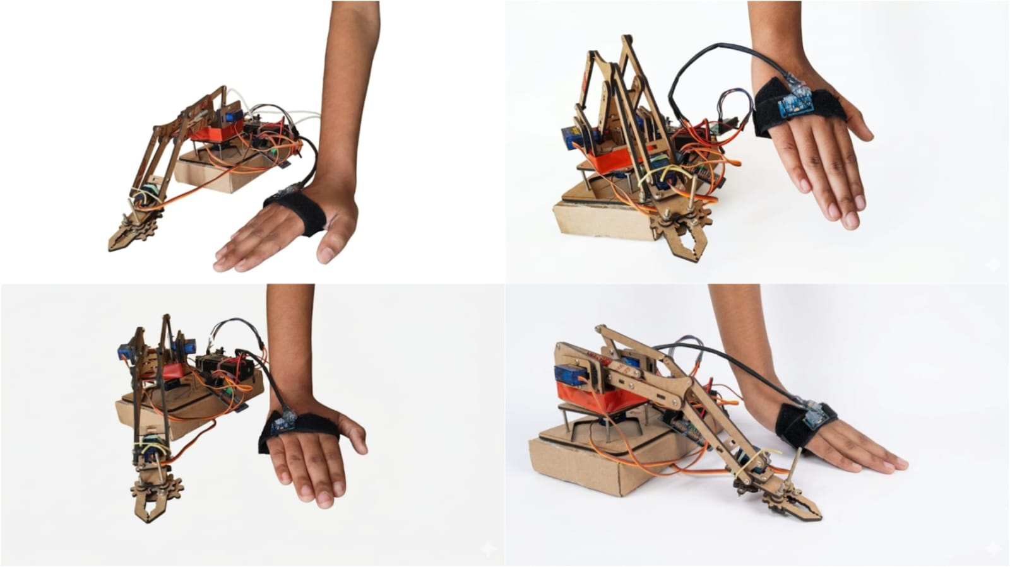
Project Output :
The image shows the robotic arm project
working model.
Hand movements are captured using the
MPU9250 sensor.
The sensor is attached to the user’s hand.
Raspberry Pi Zero 2W processes the motion data.
Machine learning predicts servo motor angles.
Motion data is sent wirelessly to the ESP32.
PCA9685 PWM Driver controls the servo motors.
Servo motors move the robotic arm according
to hand motion.
Different images show different robotic
arm positions.
The system performs real-time gesture-
based robotic control.

Slide 11
Applications:
Gesture-based robotic arm control
Industrial automation and object handling
Assistive system for physically challenged or paralysis patients
Remote robotic control applications
Human motion tracking systems
Pick-and-place robotic operations
Medical and rehabilitation support systems
Educational and research purposes in robotics and AI

Slide 12
Conclusion:
Our system developed a robotic arm that can be controlled using hand gestures. The MPU9250 sensor captures hand movements, and the Raspberry Pi Zero 2W processes the data to control the robotic arm. Machine learning is used to improve movement accuracy and make the robotic arm move smoothly. This system can be used in automation, medical support, and remote robotic control applications.

Slide 13
References :
[1] Lovanshi, M., Tiwari, V., Singh, A., & Ingle, R. (2024, December). Efficient Real-Time Human Activity Recognition with IoT Sensor Data Using Conditionally Parametrized Convolutions. In 2024 IEEE 4th International Conference on ICT in Business Industry & Government (ICTBIG) (pp. 1-6). IEEE.
[2]Umar, A., Tripathi, S., & Mahato, B. (2024, December). Feedback Simulation using IMU and Servo Motor. In 2024 1st International Conference on Sustainability and Technological Advancements in Engineering Domain (SUSTAINED) (pp. 232-238). IEEE.
[3]Kamaruzaman, K. A., Yahaya, S. Z., Noorsal, E., Boudville, R., Ahmad, F., & Soh, Z. C. (2023, August). Development of a sensory unit using a single IMU sensor for knee joint movement. In 2023, IEEE 13th International Conference on Control Systems, Computing and Engineering (ICCSCE) (pp. 353-357). IEEE.
[4]Mohammadi, M., Al-Fuqaha, A., Sorour, S., & Guizani, M. (2018). Deep learning for IoT big data and streaming analytics: A survey. IEEE Communications Surveys & Tutorials, 20(4), 2923-2960.
[5]Bharadwaz, P. J., Shaju, V. M., Jayanth, B. S., Chaitanya, D., Reddy, M. N., & Bukya, M. (2025, January). Electronic Circuit Design for an Autonomous Blimp Using Raspberry Pi Zero 2W. In 2025 International Conference on Next Generation Communication & Information Processing (INCIP) (pp. 1040-1043). IEEE.

Slide 14
[6]binti Rasidi, N. I., Al-Sanjary, O. I., Kashmola, M. Y., & Aik, K. L. T. (2022, December). Development on Autonomous Object Tracker Robot using Raspberry Pi. In 2022 IEEE 10th Conference on Systems, Process & Control (ICSPC) (pp. 29-33). IEEE.
[7]Agrawal, A. K., Kumar, J., Kumar, A., & Arvind, P. (2024, February). Enhancing human-robot interaction through PID control and sensor integration. In 2024 3rd International conference on Power Electronics and IoT Applications in Renewable Energy and its Control (PARC) (pp. 540-546). IEEE.
[8]Safa, A., & Al-Zawqari, A. (2024, December). Co-design of a robot controller board and indoor positioning system for IoT-enabled applications. In the 2024 International Conference on Microelectronics (ICM) (pp. 1-6). IEEE.
[9]Kapula, P. R., Deekonda, A., Dubey, S., Sushannth, B., Srikar, B. S., & Reddy, B. V. (2023, June). Design and Implementation of a Motion Imitation Robot. In 2023, the 5th International Congress on Human-Computer Interaction, Optimization and Robotic Applications (HORA) (pp. 1-5). IEEE
[10]Bingol, O., Tasdelen, K., Keskin, Z., & Kocaturk, Y. E. (2014). Web-based smart home automation: PLC-controlled implementation. Acta Polytechnica Hungarica, 11(3), 51-63.
[11]Sztipanovits, J., Koutsoukos, X., Karsai, G., Kottenstette, N., Antsaklis, P., Gupta, V.,…& Wang, S. (2011). Toward a science of cyber–physical system integration. Proceedings of the IEEE, 100(1), 29-44

Slide 15
[12]Pillai, A. S., & Raj, A. (2022, October). Modeling & Verification of an Adaptive IoT System using Uppaal. In 2022 IEEE 3rd Global Conference for Advancement in Technology (GCAT) (pp. 1-5). IEEE
[13]Stern, R. E., Cui, S., Delle Monache, M. L., Bhadani, R., Bunting, M., Churchill, M.,
... & Work, D. B. (2018). Dissipation of stop-and-go waves via control of autonomous vehicles: Field experiments. Transportation research part C: emerging technologies, 89, 205-221.
[14]Mishi, M. R., Bibi, R., & Ahsan, T. (2017, February). Multiple motion control system of robotic car based on IoT to produce cloud service. In 2017 International Conference on Electrical, Computer and Communication Engineering (ECCE) (pp. 748-751). IEEE.
[15]Koyasako, Y., Suzuki, T., Kim, S. Y., Kani, J. I., & Terada, J. (2020, January). Real-time motion control method using measured delay information on access edge computing. In 2020 IEEE 17th Annual Consumer Communications & Networking Conference (CCNC) (pp. 1-4). IEEE.
[16]Wang, W. (2013). Status and development trend of inertial technology. Acta Automatica Sinica, 39(6), 723-729
[17]Umar, A., Tripathi, S., & Mahato, B. (2024, December). Feedback Simulation using IMU and Servo Motor. In 2024 1st International Conference on Sustainability and Technological Advancements in Engineering Domain (SUSTAINED) (pp. 232-238). IEEE.
[18]Perissinotto, C. M., Cenzer, I. S., & Covinsky, K. E. (2012). Loneliness in older persons: a predictor of functional decline and death. Archives of internal medicine, 172(14), 1078- 1084.

Slide 16
[19]Wang, C., & Nonaka, T. (2021, October). Monitoring System for Balance Board
Simulating Side-riding Board Sports. In 2021 IEEE 10th Global Conference on Consumer Electronics (GCCE) (pp. 415-416). IEEE.
[20]Moriya, K., Nakagawa, E., Fujimoto, M., Suwa, H., Arakawa, Y., Kimura, A., ... & Yasumoto, K. (2017, March). Daily living activity recognition with Echonet Lite appliances and motion sensors. In 2017 IEEE International Conference on Pervasive Computing and Communications Workshops (PerCom Workshops) (pp. 437-442). IEEE.
[21]Raja, G., Essaky, S., Ganapathisubramaniyan, A., & Baskar, Y. (2022). Nexus of deep reinforcement learning and leader–follower approach for AIoT enabled aerial networks. IEEE Transactions on Industrial Informatics, 19(8), 9165-9172.

Slide 17
Thank You

